Slide 1
POSTCHOLECYSTECTOMY SYNDROME
(ПОСТХОЛЕЦИСТЭКТОМИЧЕСКИЙ СИНДРОМ)

Slide 2
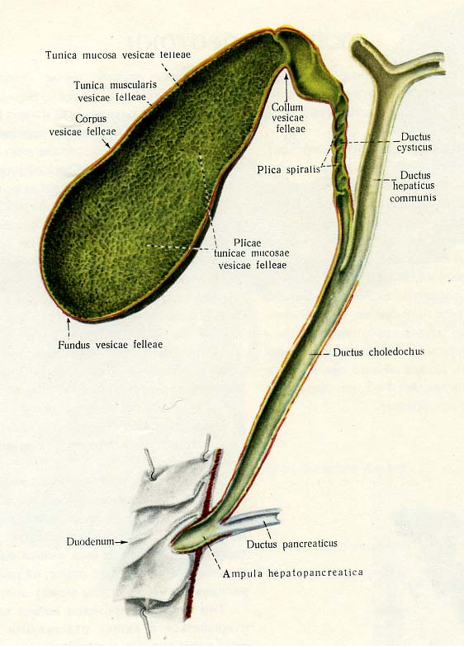
Surgical anatomy of the gall bladder and the bile duct
Notes:
Gallbladder, cystic duct, Right hepatic duct, left hepatic duct, common hepatic duct, pancreatic duct, common bile duct, ampulla of Vater, sphincter of Oddi

Slide 3
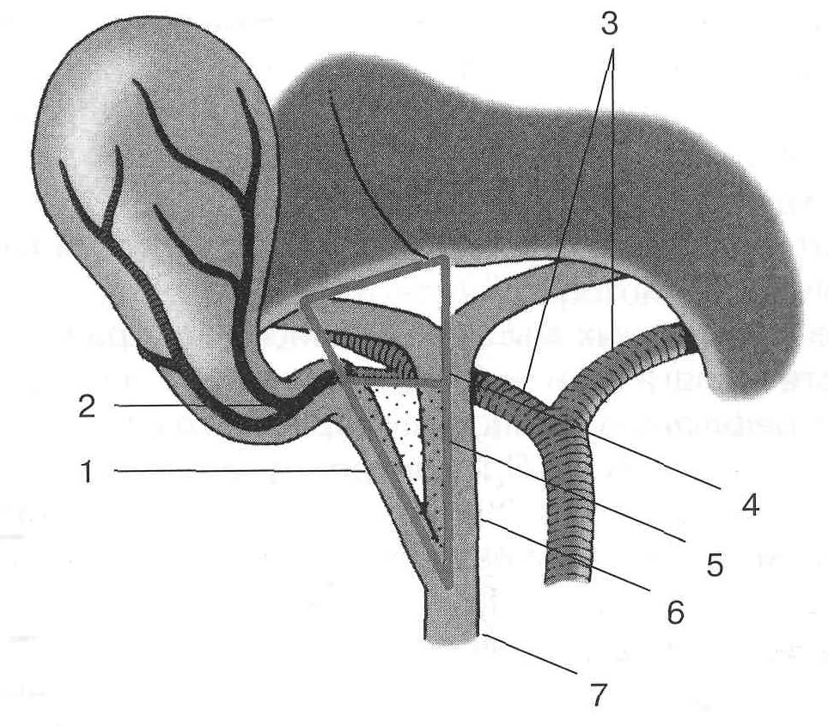
Calot's triangle (Треугольник Кало)
1 – cystic duct; 2 – cystic artery (пузырная артерия); 3 – правая и левая печеночная артерии; 4 – hepatobiliary triangle (печеночнопузырный треугольник); 5 – Calot's triangle(Треугольник Кало, заштрихован); 6 – common hepatic duct; 7 – common bile duct.
Notes:
Gallbladder, cystic duct, Right hepatic duct, left hepatic duct, common hepatic duct, pancreatic duct, common bile duct

Slide 4
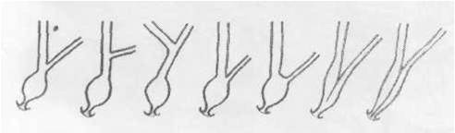
Variants of the connection of the common bile duct with the pancreatic duct

Slide 5
Термин "постхолецистэктомический синдром" (ПХЭС) - сложный симптомокомплекс, наблюдающийся у ряда больных, перенесших холецистэктомию, обусловленный не диагностированными до операции или развившимися после нее разнообразными заболеваниями желчных протоков, а также других органов и систем организма.
Postcholecystectomy syndrome" (PHEC) -complex of symptoms, which is observed in a patients who underwent cholecystectomy, which was caused by a variety of diseases of the bile ducts and other organs, not diagnosed before operation or developed after it. PHEC is not disease.

Slide 6
Symptoms of postcholecystectomy syndrome:
Persistent pain in the upper right abdomen
Dyspepsia, nausea and vomiting
Jaundice

Slide 7
Symptoms occur in about 5 to 40 percent of patients who undergo cholecystectomy.
The ratio of sick men and women is 1-5.

Slide 8
CAUSES OF POSTCHOLECYSTECTOMY SYNDROME
(Гальперин Э.И., 1988) :
1) diagnostic errors in the preoperative period and (or) during the operation;
2) tactical errors during the operation;
3) technical errors during the operation.

Slide 9
DIAGNOSTIC ERRORS
Incomplete examination of the patient before operation - diseases of organs and systems that are accompanied by pain in the right hypochondrium are not revealed
Incomplete examination of the organs of the hepatopancreatoduodenal zone during operation.

Slide 10
TACTICAL ERRORS DURING THE OPERATION :
Cholecystostomy (холецистостомия).
Removal of the gallbladder without regard to the state of the biliary system (удаление желчного пузыря без учета состояния желчевыделительной системы).
Suturing of hepaticoholedochus without drainage in case of injury of its wall or traumatic removal of a stone (Наложение глухого шва гепатикохоледоха при травме его стенки или травматичном удалении камня).

Slide 11
TECHNICAL ERRORS DURING THE OPERATION
1. Hepatic-duodenal ligament infiltration (отсутствие четкой визуализации элементов печеночно-двенадцатиперстной связки).
2. Incorrect tactics in case of sudden bleeding (неправильная тактика при внезапно возникшем кровотечении).
3. Incorrect tactics in case of injury to the hepaticocholedoch (неправильная тактика при «свежем» повреждении гепатикохоледоха).
4. Leaving part of the gallbladder and the long stump of the cystic duct (оставление части желчного пузыря и излишне длинной культи пузырного протока).
5. The wrong technique of suturing hepaticoholedochus (нарушение техники наложения глухого шва гепатикохоледоха).
6. Technical errors in the imposition of choledochoduodenostomy (технические погрешности при наложении холедоходуоденоанастомоза).
7. Technical errors in the dissection of the sphincter of Oddi (технические погрешности при проведении рассечения БДС).

Slide 12
V.M. Sitenko i A.I. Nechaj (1972):
Dyspeptic symptoms and abdominal pain without severe pain.
Attacks flowing like biliary colic.
А. Pathological conditions directly related to the biliary system:
Pathological conditions directly related to the biliary system:
bile duct stones;
stenosis of the duodenal papilla;
strictures of the bile ducts;
large stump of the cystic duct or the remainder of the gallbladder;
cyst of the common bile duct;
duodenal papilla failure;
foreign bodies of the bile ducts;
tumors of the biliopancreatic system;
cholangitis;
parasitic lesions of the biliary tract (ascariasis, giardiasis, etc.);
cirrhosis of the liver, chronic hepatitis;
subhepatic abscess;
dyskinesia of the biliary system (the existence of this disease is not reliably proven).

Slide 13
B. Pathological conditions related to other organs and systems:
chronic pancreatitis;
gastric or duodenal ulcer;
gastroduodenitis, gastritis;
chronic colitis;
hemolytic anemia;
diaphragmatic hernia;
renal stone disease, nephroptosis;
deforming spondylarthrosis;
diencephalic syndrome;
tumors of the stomach or intestines;
psychopathy, hysteria, drug addiction, aggravation;
functional disorders of motility in the upper gastrointestinal tract;
chronic duodenal stasis.
B. The cause of pain attacks has not been established.

Slide 14
CLASSIFICATION
Hepato-biliary system – cystic duct and gallbladder remnant, neuroma
Liver – fatty liver, sclerosing cholangitis, cirrhosis
Biliary tract – cholangitis, adhesions, cyst, choledocholithiasis, fistula
Periampullary – sphincter Oddi dyskinesia, spasm, hypertrophy; stricture, papilloma
Pancreas – pancreatitis, pancreatic stones, pancreatic cancer

Slide 15
EXTRA BILIARY
Oesophagus – hiatal hernia, achalasia
Stomach – gastritis, stomach ulcer, cancer
Duodenum – adhesions, diverticulum
Other pathologies – colitis, spondyloarthrosis, kidney stone disease, small bowel

Slide 16
Methods of examination of patients before and during primary surgery as prevention of PCES
We must answer two main questions:
Are the pains caused by calculous cholecystitis?
Is there a pathology of the main bile ducts?

Slide 17
INDICATIONS FOR OPERATING CHOLANGIOGRAPHY AND DUCT REVISION:
A history of jaundice
Jaundice at the time of surgery
expansion of the common bile duct more than 1 cm
small calculi in the bladder in combination with a wide cystic duct.
The presence of diagnosed calculi in the bile ducts at the preoperative stage
Palpable in the ducts calculi

Slide 18
ДИАГНОСТИКА ПХЭС
I. Лабораторная диагностика.
Определение уровня билирубина, трансаминаз, ЩФ.
II. Инструментальная диагностика
УЗИ
ФГДС с осмотром БДС
РХПГ
ЧЧХГ
КТГ, ЯМР
Интраоперационная холангиография
Фистулохолангиография
Пероральная, инфузионная, внутривенная холангиографии, дуоденальное зондирование – только исторический интерес
УЗИ почек, колоноскопия, ФГДС и т.д. для диагностики патологии других органов.

Slide 19
INVESTIGATIONS
Aim is to exclude complication of cholecystectomy and identify other causes
Serology - serum bilirubin, amylase, aspartate transaminase (AST), alanine transaminase (ALT)
Imaging – chest x ray, abdomen x ray, barium swallow and follow through, ultrasonography, MRCP
Esophagogastroduodenoscopy (EGD) , ERCP, MRCT

Slide 20
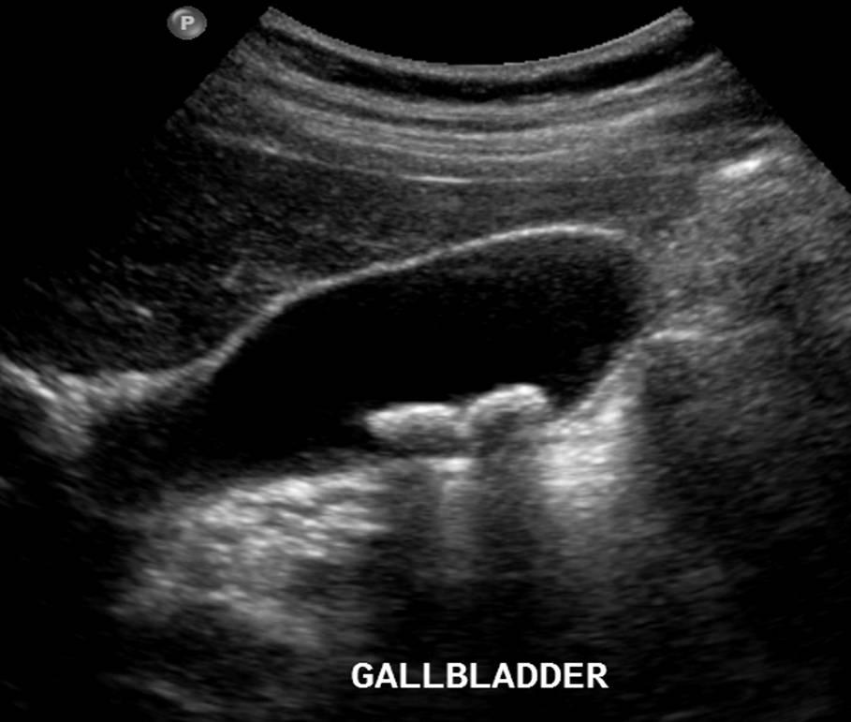
ULTRASONOGRAPHY
Posterior acoustic shadows

Slide 21
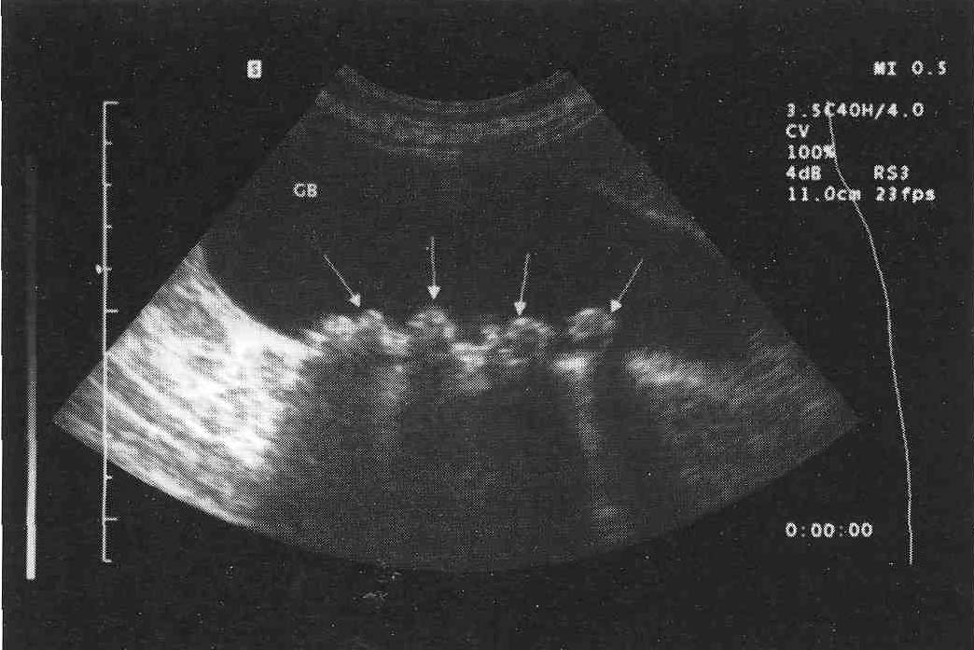
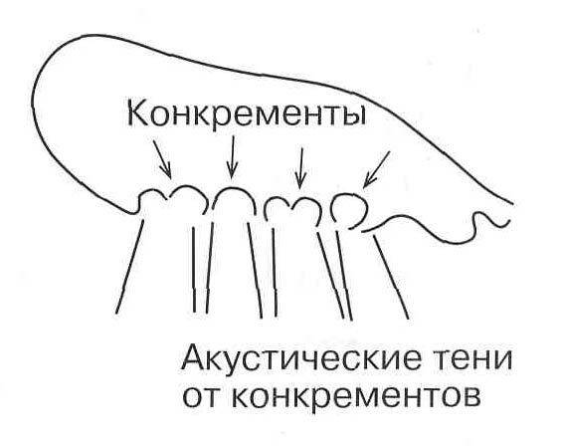
ULTRASONOGRAPHY
Ultrasound scan. Chronic calculous cholecystitis. Multiple gallstones.

Slide 22
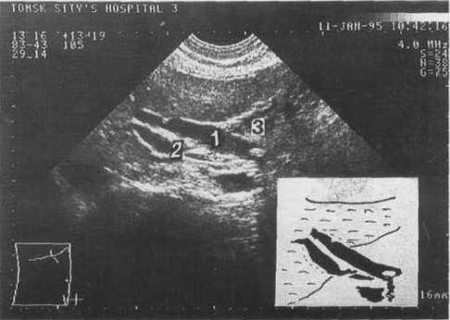
Ultrasound. Choledocholithiasis 1) common bile duct, 2) portal vein, 3) stone.

Slide 23
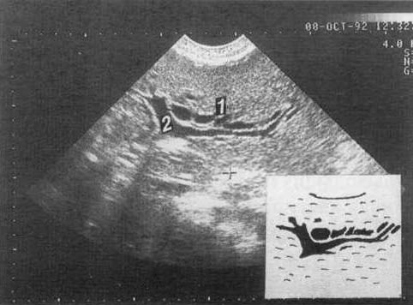
Expansion of the intrahepatic bile ducts.
1) bile ducts; 2) branches of the portal vein.

Slide 24
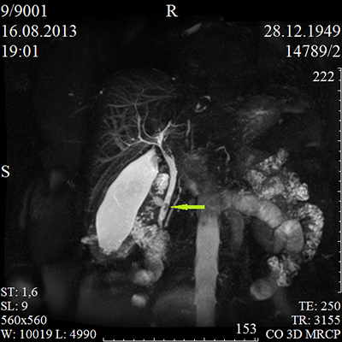
Magnetic resonance cholangiopancreatography (MRCP)
Notes:
Magnetic resonance cholangiopancreatography (MRCP) is a medical imaging technique that uses magnetic resonance imaging to visualize the biliary and pancreatic ducts in a non-invasive manner.^{[1]} This procedure can be used to determine if gallstones are lodged in any of the ducts surrounding the gallbladder.
Technique[edit]
MRCP makes use of heavily T2-weighted MRI pulse sequences.^{[3]} These sequences show high signal in static or slow moving fluids within the gallbladder, biliary ducts and pancreatic duct, with low signal of surrounding tissue.
Comparison to other techniques[edit]
In the diagnosis of pancreatic disorders, MRCP is a much less invasive investigation when compared to endoscopic retrograde cholangiopancreatography (ERCP). Although both techniques can image the ductal system in detail, MRCP also allows imaging of the surrounding parenchyma. In a study from 2008, 269 patients undergoing both ERCP and MRCP showed comparable results between the two techniques.^{[4]}

Slide 25
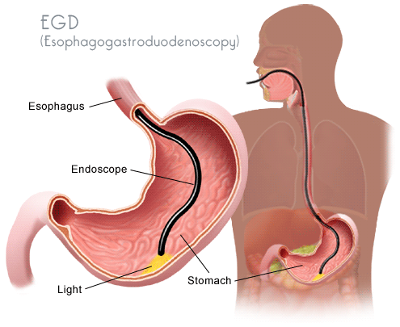
Esophagogastroduodenoscopy (EGD)

Slide 26
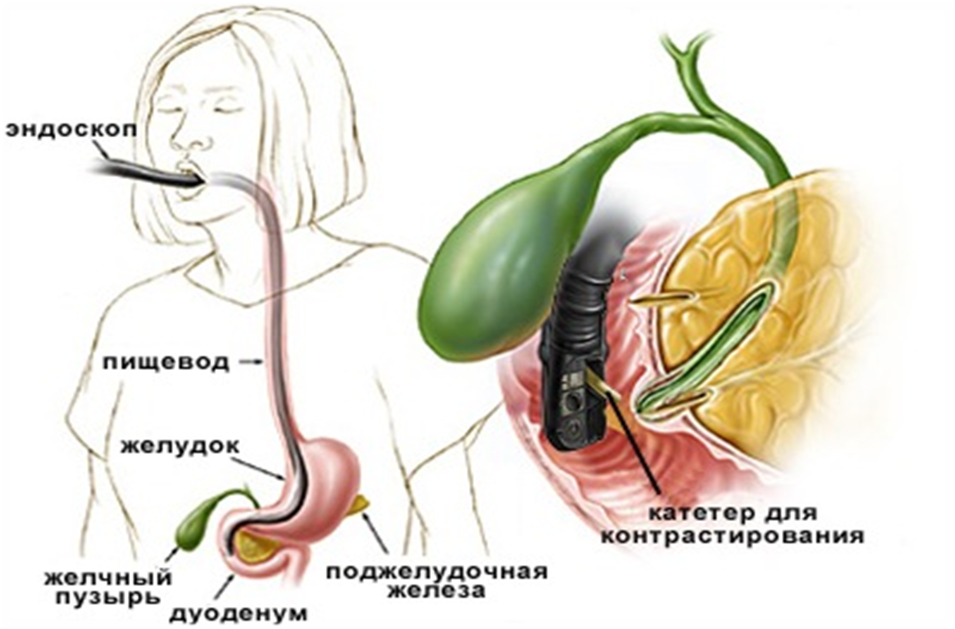
Endoscopic retrograde cholangiopancreatography (ERCP) , ЭРХПГ

Slide 27
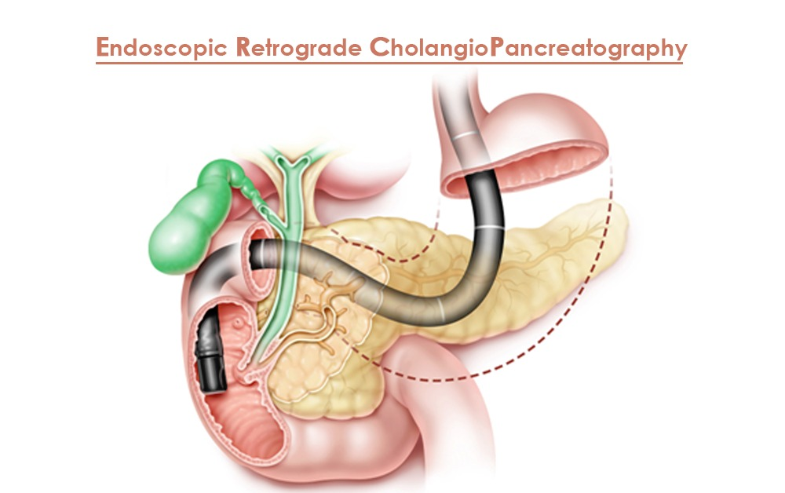

Slide 28
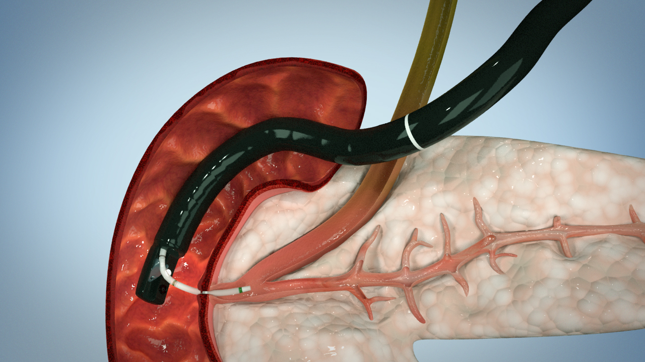
Endoscopic retrograde cholangiopancreatography (ERCP)

Slide 29
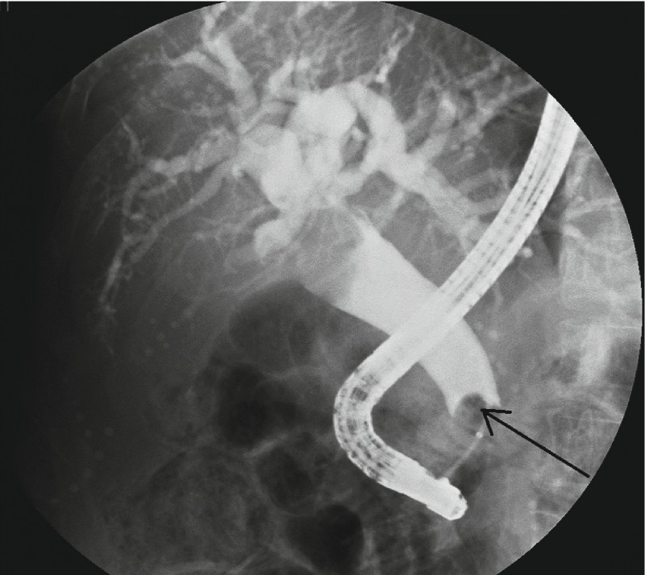

Slide 30
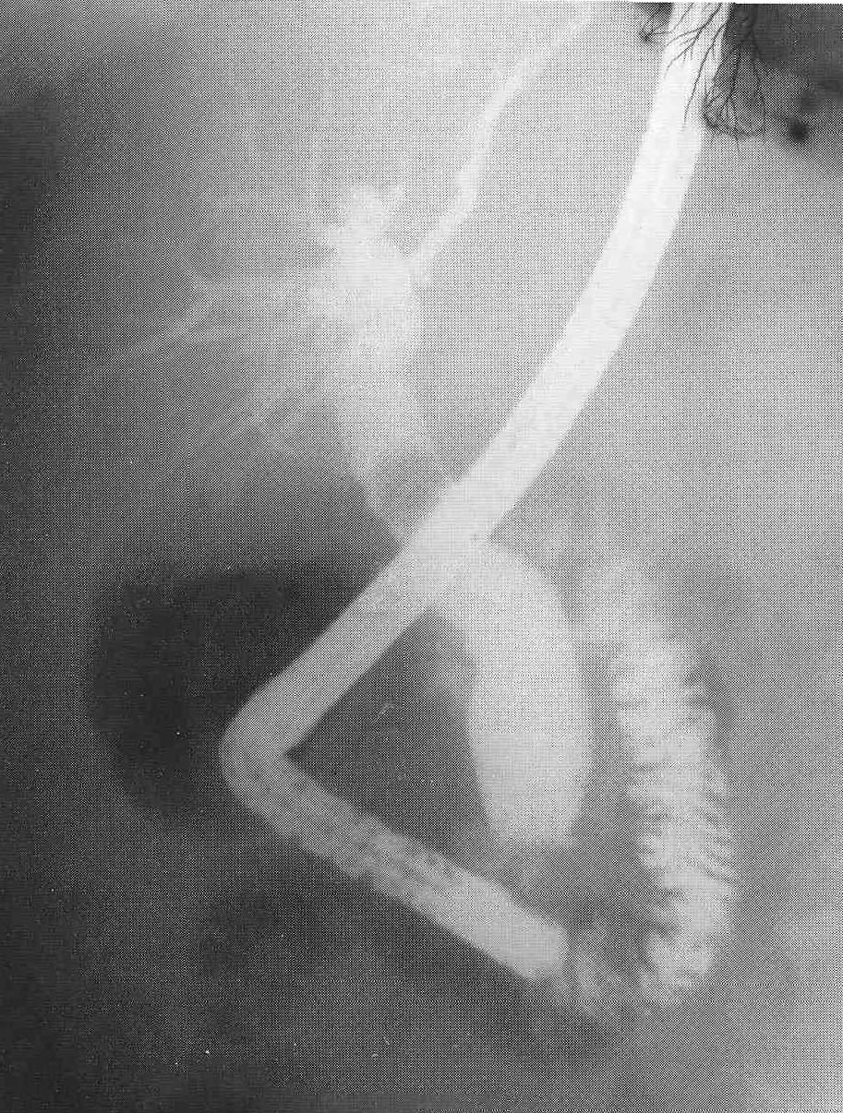
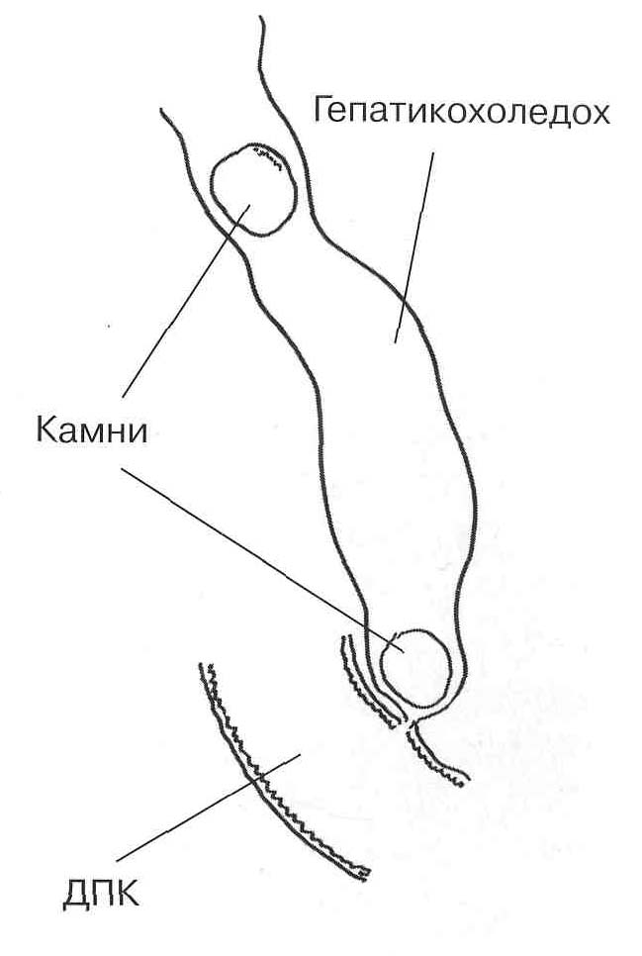
ERCP. Choledocholithiasis.

Slide 31
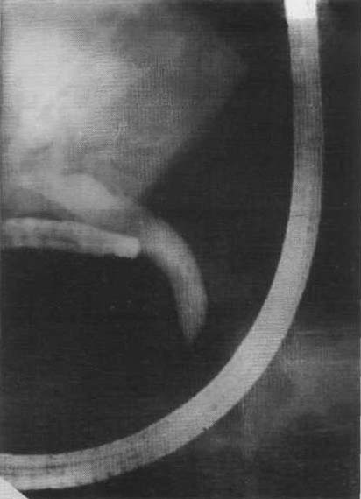
ERCP. Stenosis of the terminal part of the common bile duct. Narrowing it in the form of a "writing" pen.

Slide 32
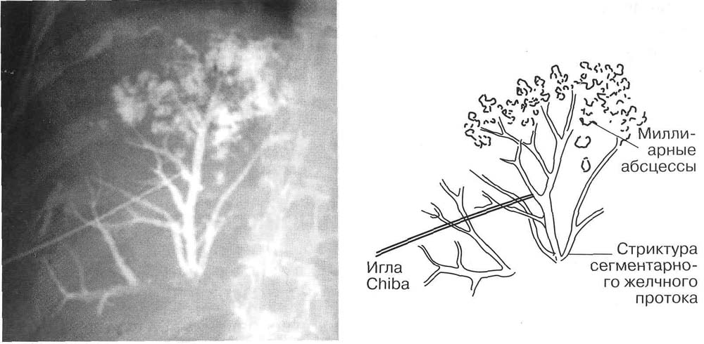
Percutaneous biliary drainage
Percutaneous transhepatic cholangiography of a patient with cicatricial stricture of a segmental bile duct with miliary abscesses.

Slide 33
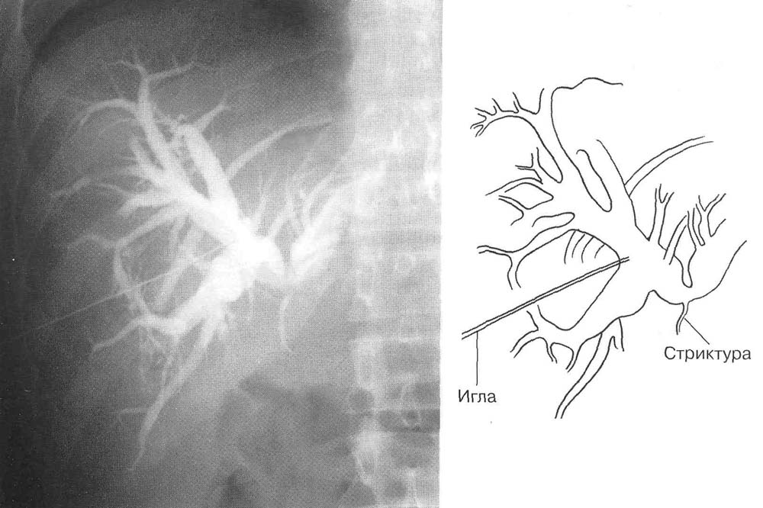
Percutaneous biliary drainage
Cicatricial stricture of the common hepatic duct.

Slide 34
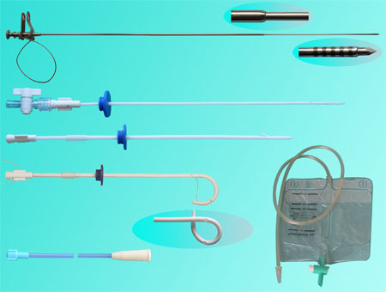

Slide 35
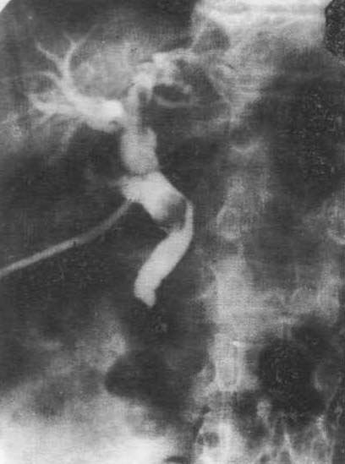
Intraoperative cholangiogram. A stone in the common bile duct in combination with stenosis of the large duodenal papilla.

Slide 36
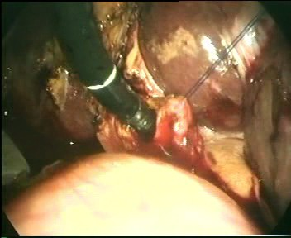
CHOLEDOCHOSCOPY

Slide 37
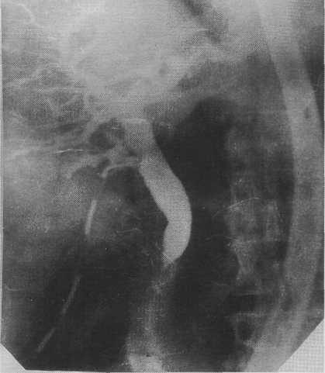

Slide 38
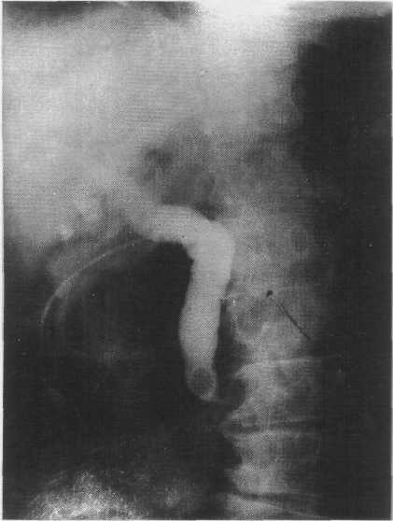

Slide 39
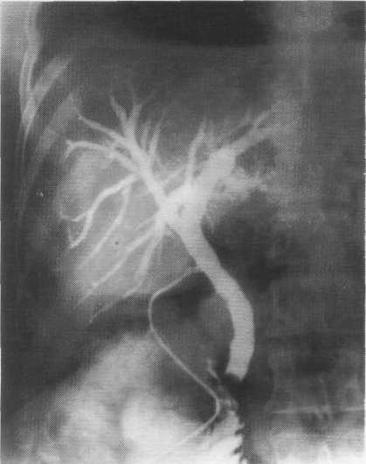

Slide 40
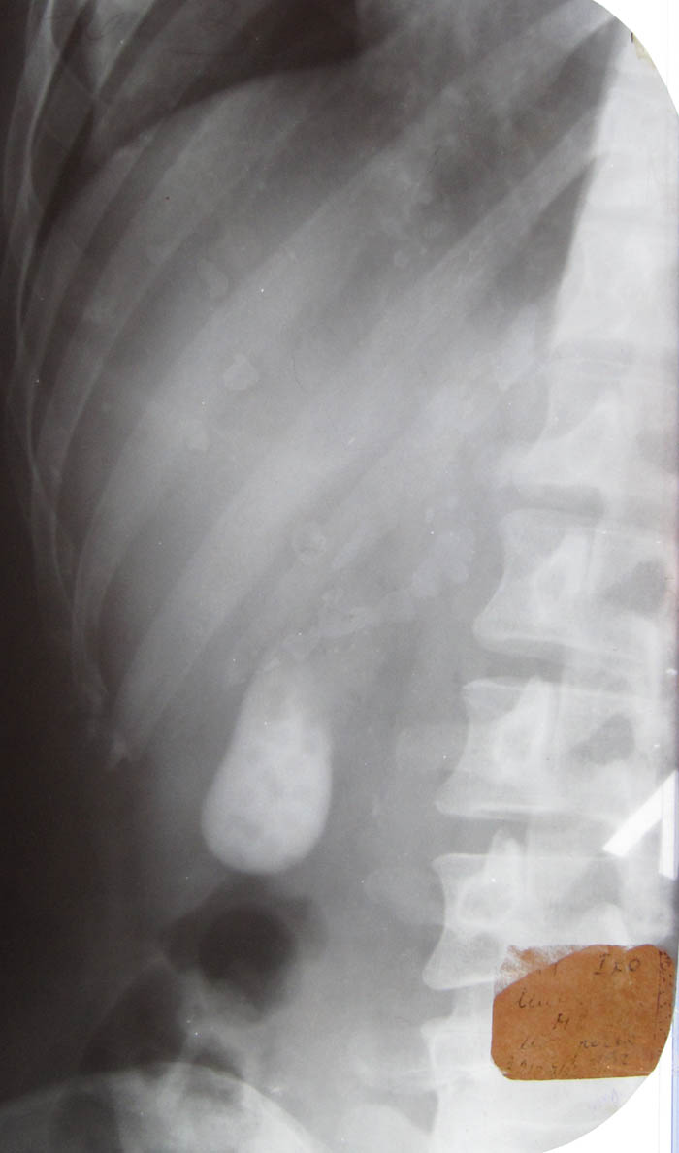
Oral cholecystography
For 12 - 24 hours before x-ray examination, 3-6 g of bilimin are prescribed inside.
In the morning of 9 - 10 hours an X-ray examination is carried out.
Then after 45-60 minutes. after taking a choleretic breakfast, the evacuation and contractile functions of the gallbladder are determined.

Slide 41
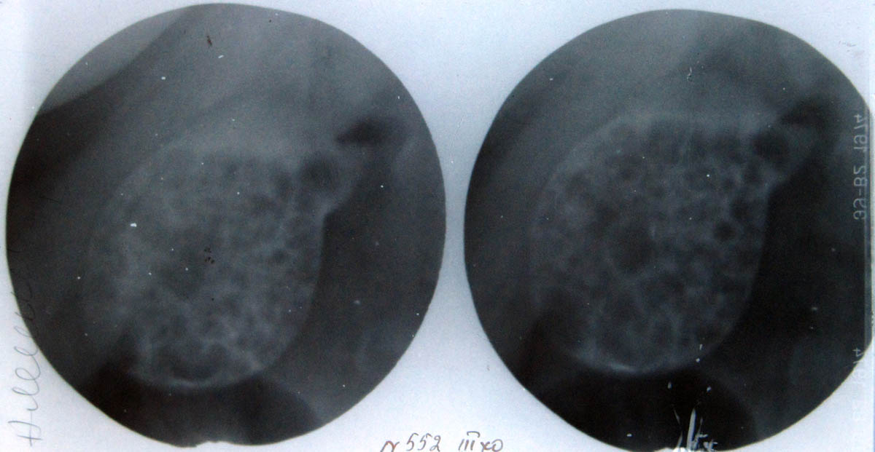

Slide 42
Choledocholitiasis
Stones in bile ducts
According to the mechanism of appearance in the biliary tract, they distinguish:
Stones not found during the primary operation (primary, residual)
newly formed in CBD (secondary, recurrent).
combination of primary and secondary stones.

Slide 43
Causes of residual choledocholithiasis
Choledocholithiasis is not recognized, revision of the ducts is not performed.
Defective duct revision.

Slide 44
Reasons for recurrent choledocholithiasis:
factors that were not recognized and not eliminated during the operation or developed after it and slowing down the outflow of bile into the duodenum (cicatricial strictures of the biliary tract and terminal part of the common bile duct, stenosis of the papilla of Vater);
foreign bodies in the ducts, which are the matrix for subsequent stone formation;
increased lithogenicity of bile.

Slide 45
Clinical of choledocholitiasis
Abdominal pain
Jaundice
Cholangitis
Intermitent jaundice due to ball-valve action of the stone (особая форма – вентильный холедохолитиаз, характеризующийся перемежающейся желтухой)

Slide 46
Ultrasound. Choledocholithiasis 1) common bile duct, 2) portal vein, 3) stone.

Slide 47
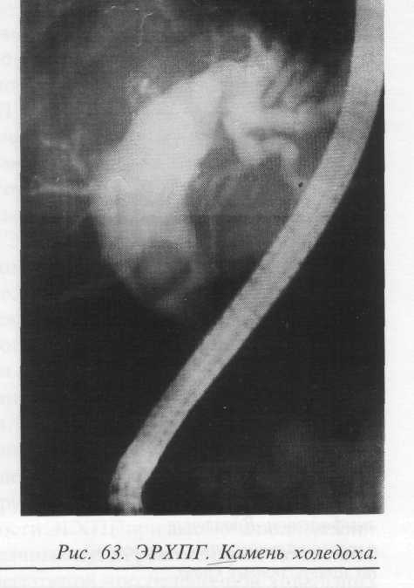

Slide 48
ERCP. Choledocholithiasis.

Slide 49
Treatment
ERCP sphincterotomy and basketing (эндоскопическая папиллосфинктеротомия в сочетании с удалением камней из холедоха петлей Дормиа, катетером Фогарти)
Laparotomy, choledochotomy are rarely performed.

Slide 50
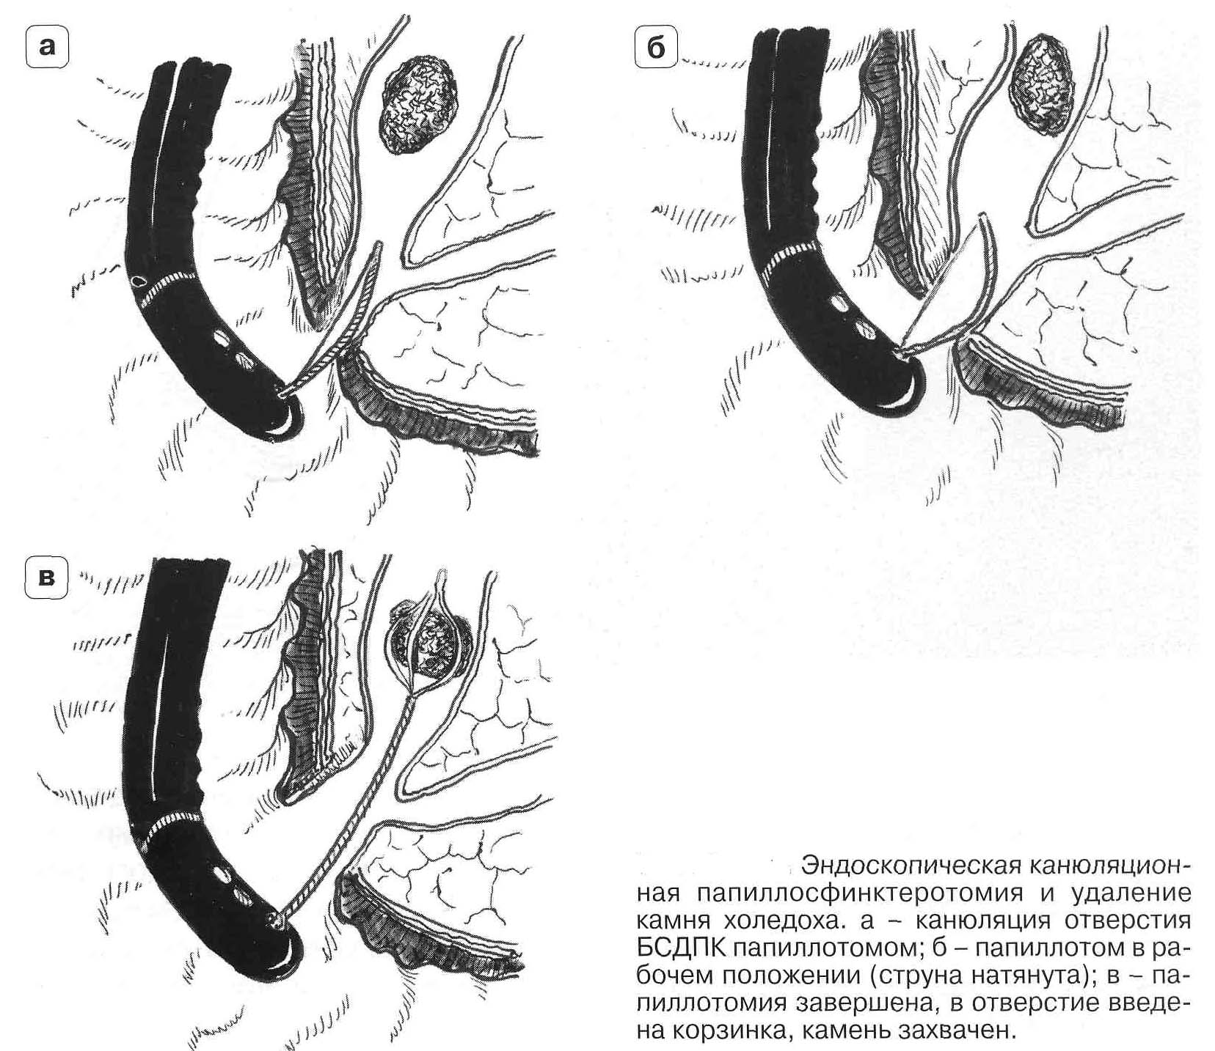

Slide 51
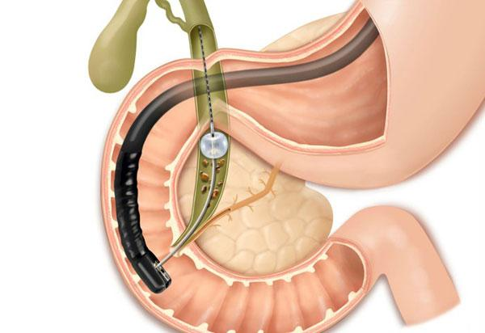

Slide 52
If stones in the common bile duct cannot be removed using ERCP and endoscopic papillosphincterotomy, then laparotomy, removal of stones from the common bile duct, will be performed. After that, a T-shaped drainage (Kera drainage) is established in the common bile duct and the operation is completed.

Slide 53
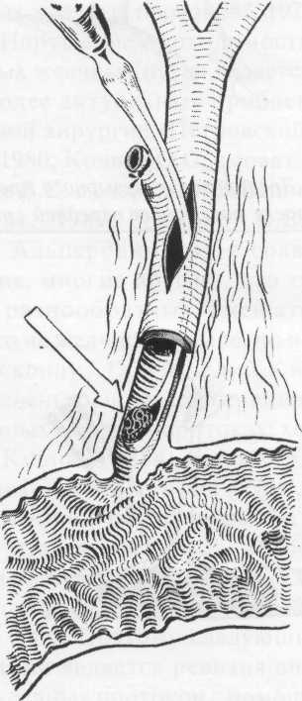

Slide 54
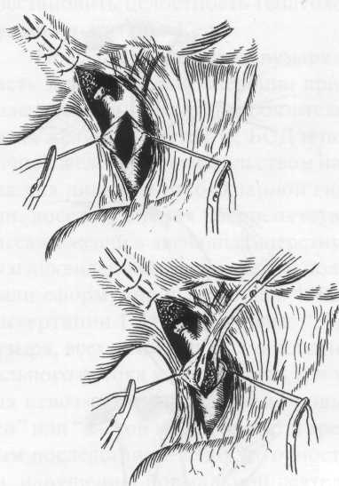

Slide 55
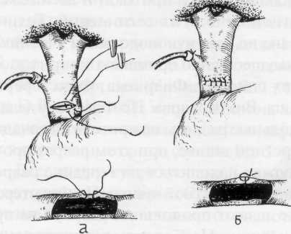

Slide 57
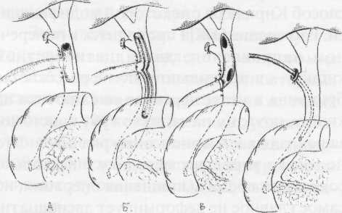

Slide 58
Stenosis of the Vater papilla
By etiology: primary, secondary
By prevalence: isolated, extended
By the degree of narrowing:
1 degree diameter BDS more than 3 mm
2 degree diameter 1-3 mm
3 degree diameter is less than 1mm.

Slide 59
Clinic stenosis of Vater papilla:
Pain in the right hypochondrium
Obstructive jaundice
Cholangitis
Perhaps the development of pancreatitis

Slide 60
ERCP. Stenosis of the terminal part of the common bile duct. Narrowing it in the form of a "writing" pen.

Slide 61
An alternative method of treating stenosis of the large duodenal papilla – laparotomy, duodenotomy, transduodeal papillosphincterotomy, and the application of choledochoduodenoanastomosis.

Slide 62
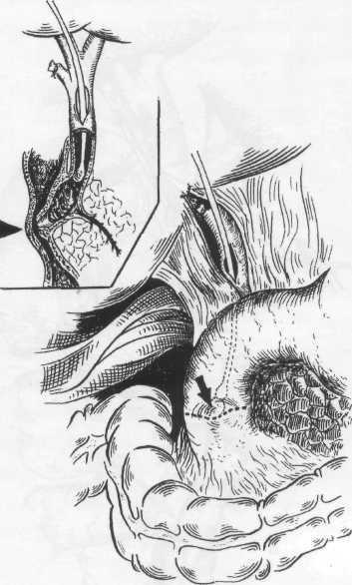

Slide 63
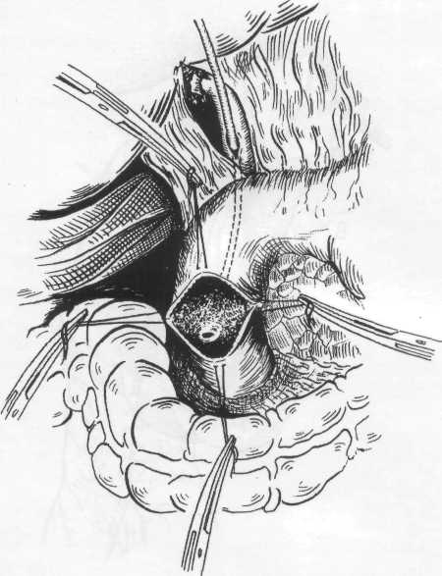

Slide 64
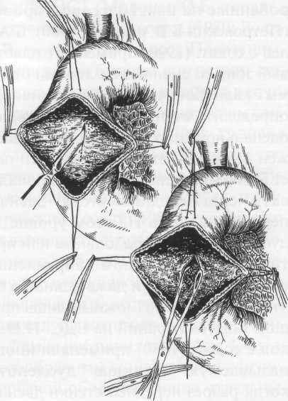

Slide 65
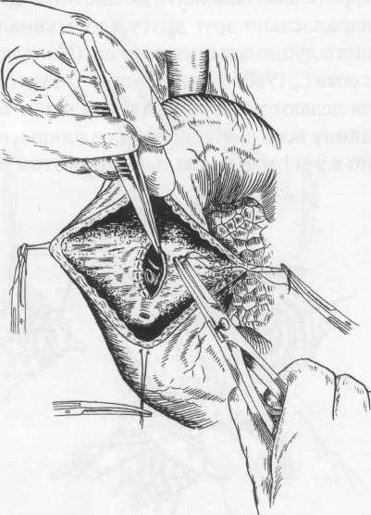

Slide 66
Insufficiency of Vater papilla
Functional
Organic
Clinic
Pain in the right hypochondrium
Obstructive jaundice
Cholangitis

Slide 67
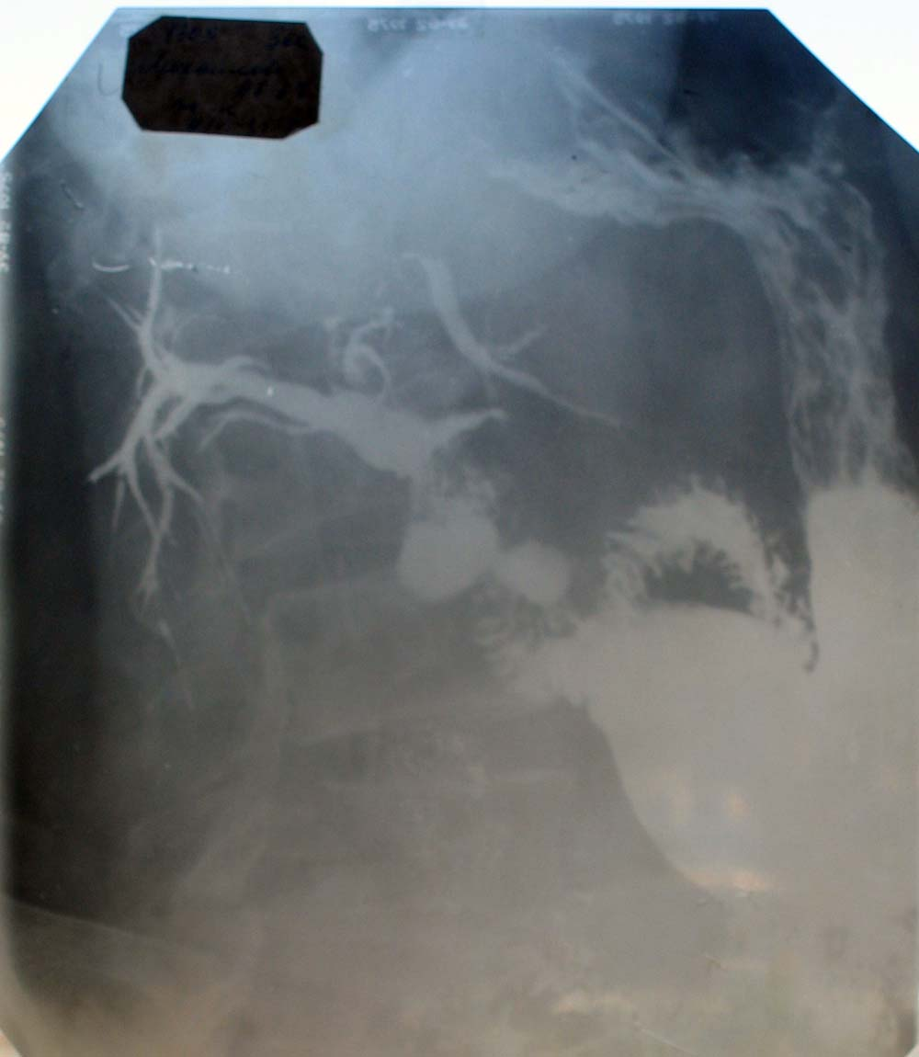
Insufficiency of Vater papilla

Slide 68
Surgical treatment options for insufficiency of Vater papilla
Alcohol-novocaine blockade of the solar plexus - the introduction of 10 ml of a 0.5% solution of novocaine and 3-4 ml of 70% alcohol into the retroperitoneal space and along the right celiac nerve;
Surgery on the celiac nerves - resection or intersection of the celiac nerves, bilateral sympathectomy, removal of the nodes of the solar plexus.

Slide 69
CHOLANGITIS CLASSIFICATION
I. по этиологии: бактериальные, гельминтозные, токсикоаллергические, вирусные, аутоиммунные;
II. по патогенезу:
а) первичные (первично-склерозирующие, аутоиммунные)
б) вторичные (бактериальные, гельминтозные и т. д.)
III. по течению:
а) острые б) хронические;
IV. по характеру морфологических изменений:
а) острый холангит: катаральный, флегмонозный, флегмонозно-язвенный, гангренозный;
б) хронический холангит: пролиферативный, фиброзирущий, стенозирующий;

Slide 70
CHOLANGITIS CLASSIFICATION
I. By etiology: bacterial, helminthic, toxico-allergic, viral, autoimmune;
II. By pathogenesis:
a) primary (primary sclerosing, autoimmune)
b) secondary (bacterial, helminthic, etc.)
III. with the flow:
a) acute b) chronic;
Iv. by the nature of morphological changes:
a) acute cholangitis: catarrhal, phlegmonous, phlegmonous and ulcerative, gangrenous;
b) chronic cholangitis: proliferative, fibrosing, stenotic;

Slide 71
V. по степени распространения воспалительного процесса в желчных путях:
а) сегментарный (вне- и внутрипеченочный),
б) распространенный
в) тотальный;
VI. по характеру имеющихся осложнений:
а) холангиогеннные абсцессы печени
б) септические осложнения
в) некроз и перфорация гепатикохоледоха;
г) поражение паренхимы печени в виде перихолангиолита, фиброза портальных трактов с формированием вторичного билиарного цирроза печени;
д) острая печеночная недостаточность.

Slide 72
V. according to the degree of spread of the inflammatory process in the biliary tract:
a) segmental (out-and intrahepatic),
b) common
c) total;
VI. by the nature of the complications:
a) cholangiogenic abscesses of the liver
b) septic complications
c) necrosis and perforation of the hepaticoholedochus;
d) damage to the liver parenchyma in the form of periholangiolitis, portal pathways fibrosis with the formation of secondary biliary cirrhosis;
e) acute liver failure.

Slide 73
Charcot triad
Pain in the right hypochondrium
Jaundice
Febrile hyperthermia

Slide 74
PENTAD REYNOLDS
Pain in the right hypochondrium
Jaundice
Febrile hyperthermia
Hypotension
Encephalopathy

Slide 75
IN PATIENTS WITH BACTERIAL CHOLANGITIS, EMERGENCY DECOMPRESSION OF THE BILIARY TRACT IS INDICATED:
endoscopic nasobiliary drainage through the duodenal papilla
endoscopic papillosphincterotomy alone or in combination with nasobiliary drainage
percutaneous transhepatic cholangiostomy.
An alternative method is laparotomy, choledochotomy, choledochostomy.

Slide 76
CLASSIFICATION BILIARY STRUCTURES
I. By etiology:
1. Inflammatory
a) Primary strictures, incl. Delbe's disease
b) Secondary inflammatory strictures
2. Traumatic strictures
II. By length:
1. limited (up to 2 cm)
2. extended (over 2 cm)
III. By localization:
1.high (above the confluence of the cystic duct)
0 level - bifurcation and higher
Level 1 - more than 1 cm from bifurcation
Level 2 - more than 2 cm from the bifurcation
2. low (located below this level)

Slide 77
IV. By patency of the bile ducts:
1. incomplete stricture
2. full stricture
V. According to the clinical course:
1. primary;
2. recurrent.

Slide 78
Э.И. Гальпериным в 2002 году предложена модифицированная классификация стриктур желчных протоков:
Выделяется шесть типов стриктур: тип стриктуры «+2» — культя измененного ОПП более 2 см; «+1» — культя ОПП 1-2 см; «0» — культя ОПП менее 1 см; «-1» — культи ОПП нет, сохранен верхнезадний свод конфлюенса ПП; «-2» — зона конфлюенса ПП разрушена, сохранены культи долевых протоков; «-3» — рубцово-воспалительное поражение сегментарных протоков.

Slide 79
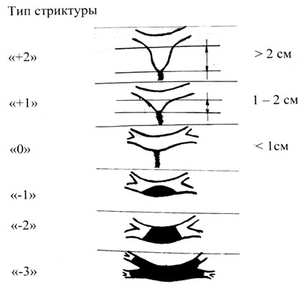

Slide 80
CLINICAL PICTURE
In the early postoperative period
1. persistent external gall fistula
2. obstructive jaundice
3. cholangitis
In the late stages of operational monitoring
1. A feeling of heaviness, fullness in the right hypochondrium, which is associated with biliary hypertension in the bile ducts.
2. transient obstructive jaundice
3. cholangitis

Slide 81
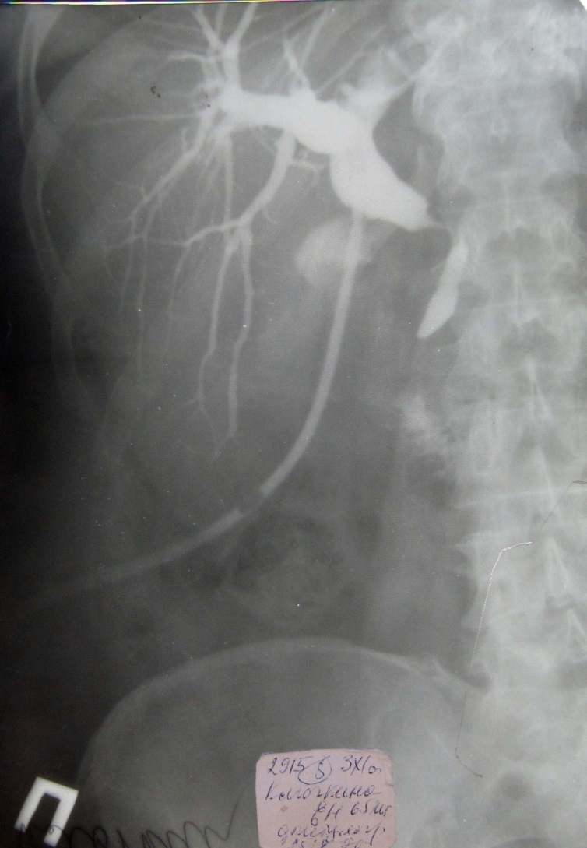
Notes:
Stricture, expansion of the common bile duct

Slide 83
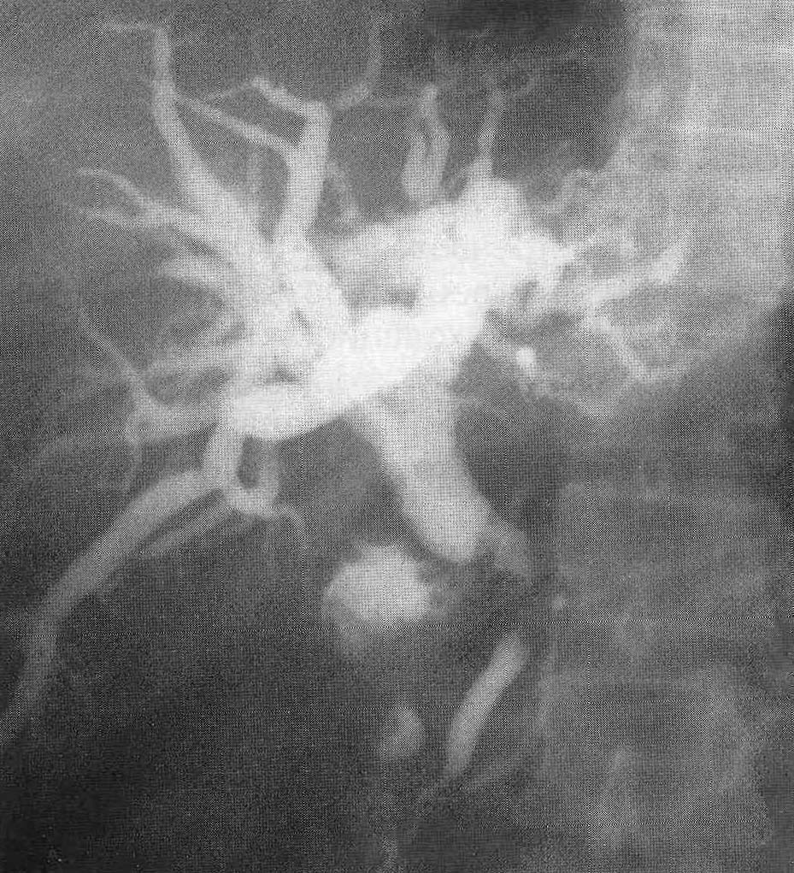
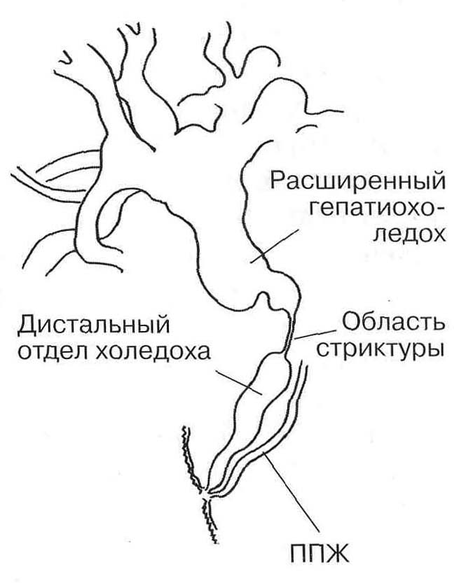
ЭРХПГ. Рубцовая стриктура холедоха.

Slide 84
TREATMENT
I. Recovery operations (restoration of patency of ducts)
1. Endobiliary interventions under ultrasound or X-ray control (bougienage, balloon dilatation, stenting of the bile duct).
2. Plastic of stricture
3. Resectable strictures can be resected with primary anastomosis.
II. Reconstructive surgery (application of biliodigestive anastomoses)
1. Extrahepatic bile duct anastomoses :
а) choledocho-duodenostomy
б) hepatico-jejunostomy.
2. Anastomoses of the intrahepatic bile ducts with a segment of the jejunum isolated by Roux or stomach with high strictures

Slide 85
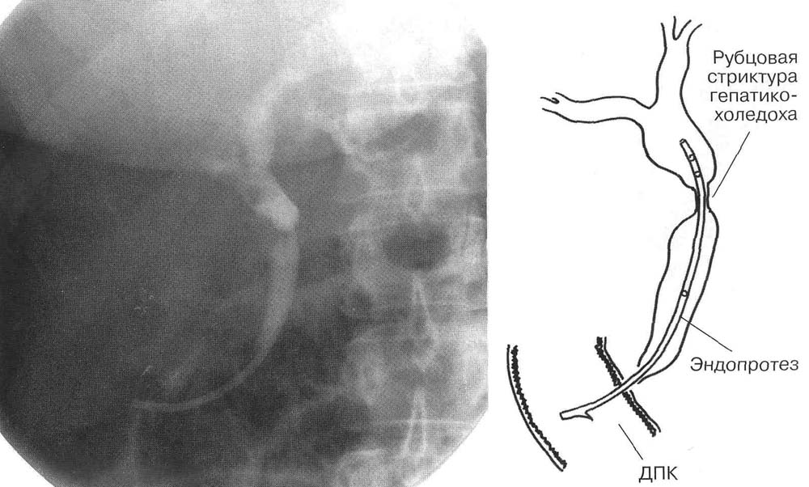
Bile duct endoprosthetics for cicatricial stricture with a plastic stent.

Slide 86
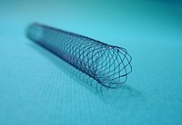
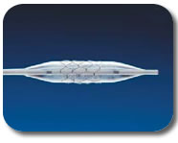
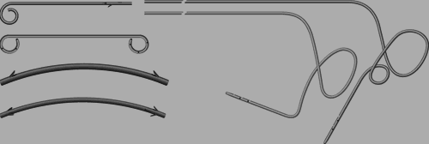
Stenting
Biliary stents: metal and plastic

Slide 87
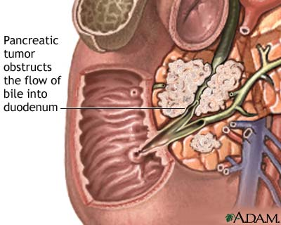

Slide 88
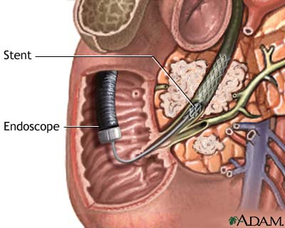

Slide 89
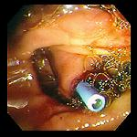

Plastic and metal stents. Endoscopic picture

Slide 90


Slide 91


Slide 92


Slide 93


Slide 94


Slide 95


Slide 96


Slide 97
Длинная культя пузырного протока
Неполное удаление пузырного протока
Билиарная гипертензия

Slide 98
Инородные тела желчных протоков
оставленные в желчных протоках во время операции
(скрытые, погружные дренажи, марлевые шарики и т. д.);
образующиеся в желчных протоках на лигатурах в результате отложения на них желчных солей и пигментов;
проникшие в желчные протоки через билиодигестивные
соустья.

Slide 99
Классификация
I. Наружные свищи
1. По происхождению:
а) Травматические – травма протоков
б) Операционные – наложенные с лечебной целью
в) В результате послеоперационных осложнений
2. По форме сообщения с внешней средой:
а) губовидные
б) трубчатые (90 %)
3. По степени оттока желчи во внешнюю среду:
а) полные
б) неполные

Slide 100
4. По характеру клинического течения:
нестойкие (рецидивирующие) и стойкие;
осложненные (гемобилия и т. д.) и неосложненные;
5. По соединению со смежными органами:
а)простые (сообщаются только с желчными путями)
б)комбинированные (сочетаются со свищами других органов)
II. Внутренние свищи

Slide 101

УЗИ. Киста холедоха.
1) Киста холедоха; 2) воротная вена; 3) нижняя полая вена; 4) правая почка.

